Slide 1


Slide 2
objectives
Compute the eigenspectral of paint pigments from the Munsell Color Chips database
Convert a color camera into a spectral imager using principal components analysis
We can accurately depict large datasets with only a few representative values through Principal Components Analysis.
RGB digital counts were found to be sufficient in reconstructing the high-dimensional spectral information even with a novel set.
Spectral (RMSE, SAM) and color error metrics (ΔE₇₆) should all be used in evaluating reconstruction as one supplements the other.
Physics-301/Activity - 4 RGB-to-Spectra using PCA.ipynb at main · reneprincipejr/Physics-301 (github.com)
https://drive.google.com/file/d/11YbzA_dpg4L-_9xB1E44XnfDiXXtFVsc/view?usp=sharing

Slide 3
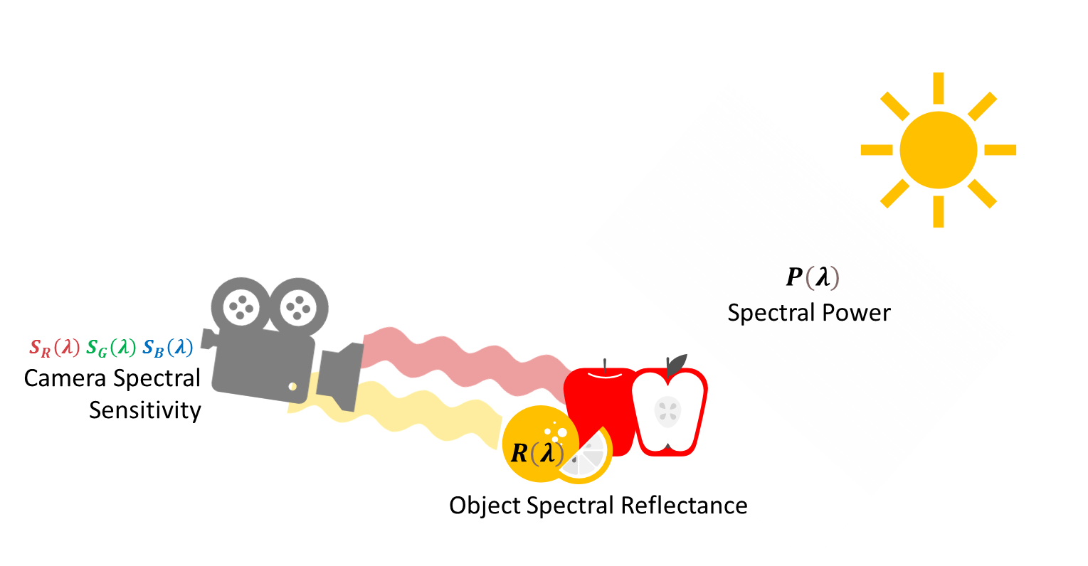
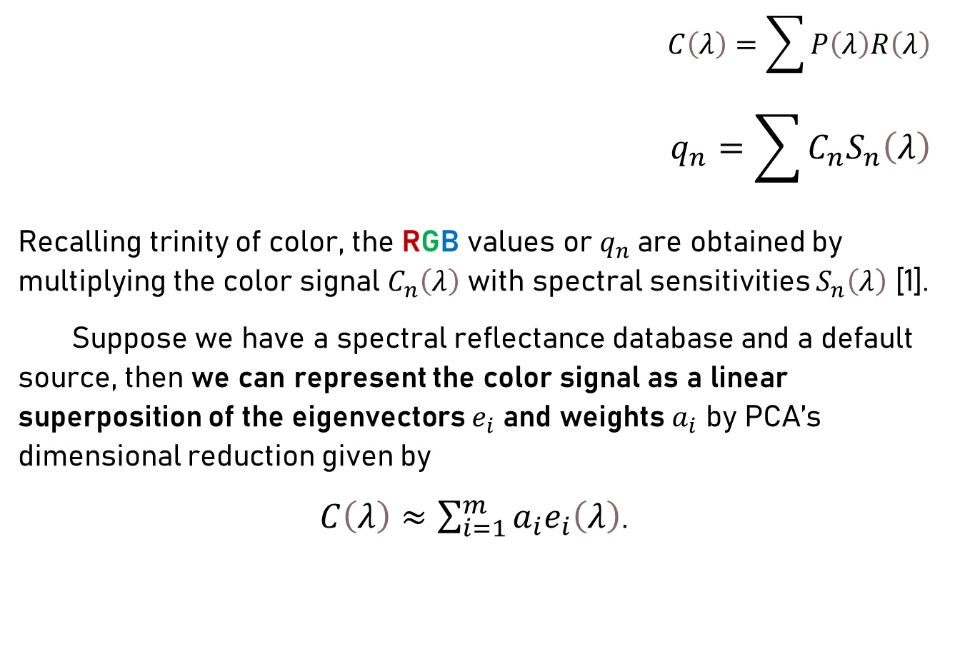
Background
$$C\left(λ\right)=\sum{P\left(λ\right)R\left(λ\right)}$$
$$q_{n}=\sum{C_{n}S_{n}\left(λ\right)}$$
Recalling trinity of color, the RGB values or $q_{n}$are obtained by multiplying the color signal $C_{n}\left(λ\right)$ with spectral sensitivities $S_{n}\left(λ\right)$ [1].
Suppose we have a spectral reflectance database and a default source, then we can represent the color signal as a linear superposition of the eigenvectors $e_{i}$ and weights $a_{i}$ by PCA’s dimensional reduction given by
$C\left(λ\right)≈\sum_{i=1}^{m}{a_{i}e_{i}\left(λ\right)}$.

Slide 4

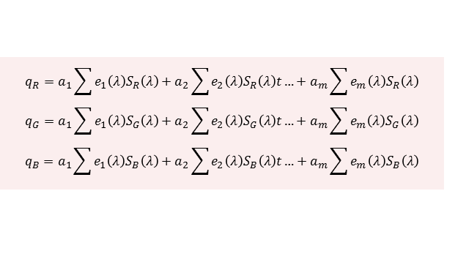
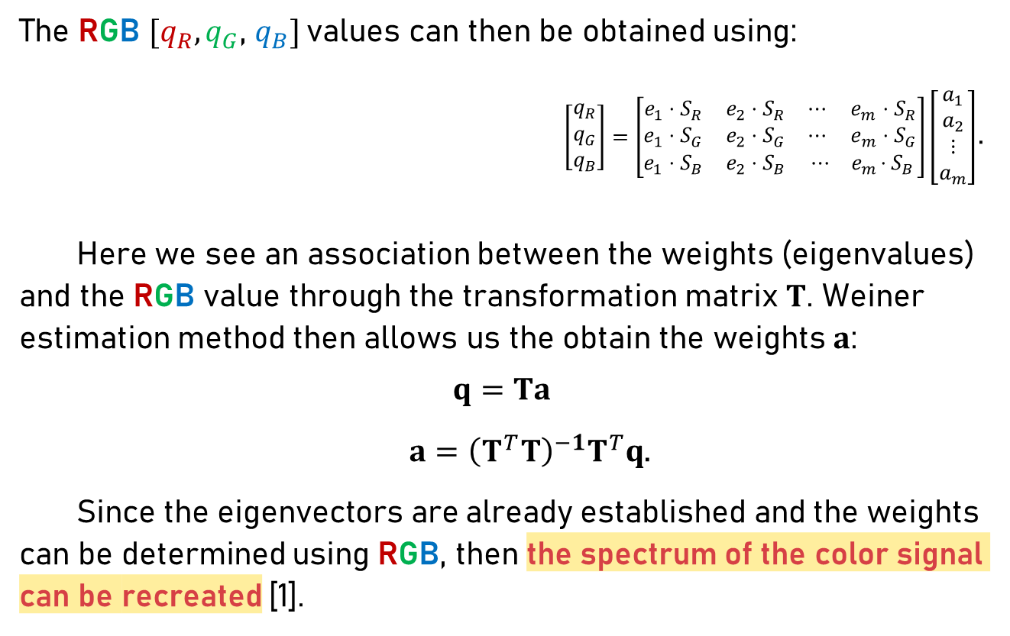
Background
The RGB $[q_{R},q_{G}$, $q_{B}]$values can then be obtained using:
$\left[\begin{matrix}q_{R} \\ q_{G} \\ q_{B}\end{matrix}\right]=\left[\begin{matrix}e_{1}⋅S_{R} & e_{2}⋅S_{R} & ⋯ e_{m}⋅S_{R} \\ e_{1}⋅S_{G} & e_{2}⋅S_{G} & ⋯ ⅇ_{m}⋅S_{G} \\ e_{1}⋅S_{B} & e_{2}⋅S_{B} & ⋯ { ⅇ}_{m}⋅S_{B}\end{matrix}\right]\left[\begin{matrix}a_{1} \\ a_{2} \\ ⋮ \\ a_{m}\end{matrix}\right]$.
Here we see an association between the weights (eigenvalues) and the RGB value through the transformation matrix $T$. Weiner estimation method then allows us the obtain the weights $a$:
$$q=Ta$$
$a={\left(T^{T}T\right)}^{−1}T^{T}q$.
Since the eigenvectors are already established and the weights can be determined using RGB, then the spectrum of the color signal can be recreated [1].
$$q_{R}=a_{1}\sum{e_{1}\left(λ\right)S_{R}\left(λ\right)}+a_{2}\sum{e_{2}\left(λ\right)S_{R}\left(λ\right)t}…+a_{m}\sum{e_{m}\left(λ\right)S_{R}\left(λ\right)}$$
$$q_{G}=a_{1}\sum{e_{1}\left(λ\right)S_{G}\left(λ\right)}+a_{2}\sum{e_{2}\left(λ\right)S_{G}\left(λ\right)t}…+a_{m}\sum{e_{m}\left(λ\right)S_{G}\left(λ\right)}$$
$$q_{B}=a_{1}\sum{e_{1}\left(λ\right)S_{B}\left(λ\right)}+a_{2}\sum{e_{2}\left(λ\right)S_{B}\left(λ\right)t}…+a_{m}\sum{e_{m}\left(λ\right)S_{B}\left(λ\right)}$$

Slide 5
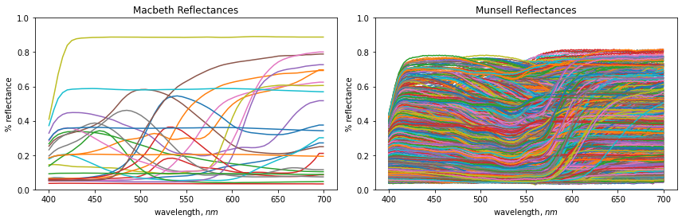

Background
Like the compression demonstrated in facial reconstruction using Principal Components Analysis (PCA) [2], here we attempt to reduce the reflectance database into a few representative eigenspectra which yields the transformation matrix $T$necessary to represent the spectral reflectance using only the input digital color [1].
To facilitate this process called spectral super-resolution, we use the 1269 Munsell color chips ensemble and then, we attempt to recover the spectra of 24 Macbeth color patches using the rendered RGB values [3].

Slide 6
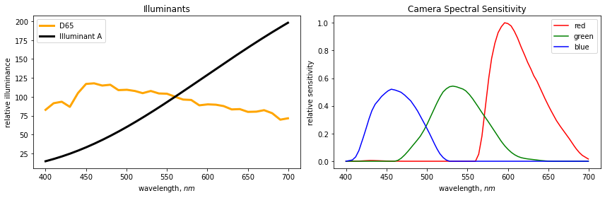
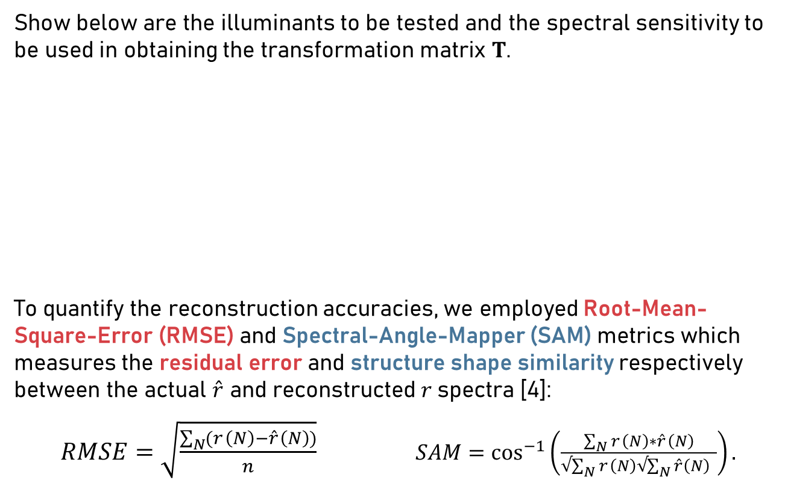
Transformation Matrix
Show below are the illuminants to be tested and the spectral sensitivity to be used in obtaining the transformation matrix $T$.
To quantify the reconstruction accuracies, we employed Root-Mean-Square-Error (RMSE) and Spectral-Angle-Mapper (SAM) metrics which measures the residual error and structure shape similarity respectively between the actual ${\hat{r}}_{ }$ and reconstructed $r$spectra [4]:
$RMSE=\sqrt{\frac{\sum_{N}{(r_{ }\left(N\right)−{\hat{r}}_{ }\left(N\right))}}{n}}$ $SAM=\cos^{−1}\left(\frac{\sum_{N}{r_{ }\left(N\right)∗{\hat{r}}_{ }\left(N\right)}}{√\sum_{N}{r_{ }\left(N\right)√\sum_{N}{\hat{r}\left(N\right) }}}\right).$

Slide 7
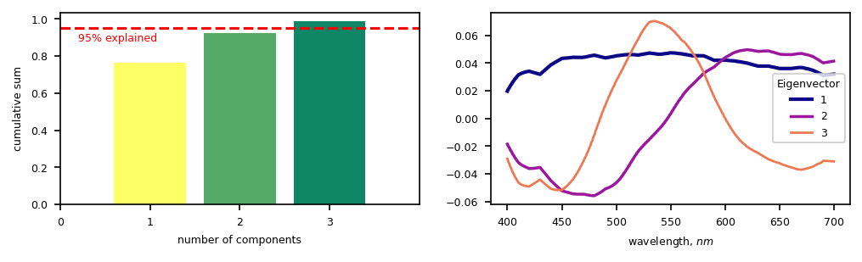
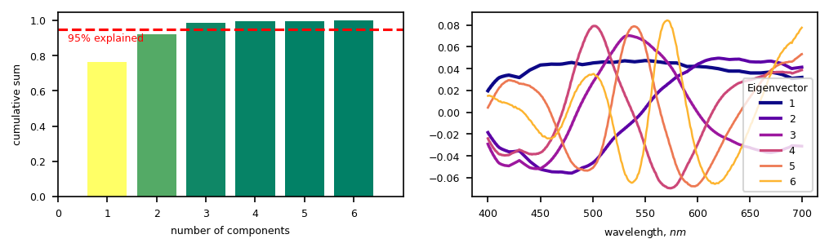
Percent Explained
Taking the cumulative sum of the normalized eigenvalues, we can see that three (3) principal components can represent 95% of the variance in the Munsell reflectance database. Therefore, we expect a spectrum to be properly represented using only three input values.

Slide 8
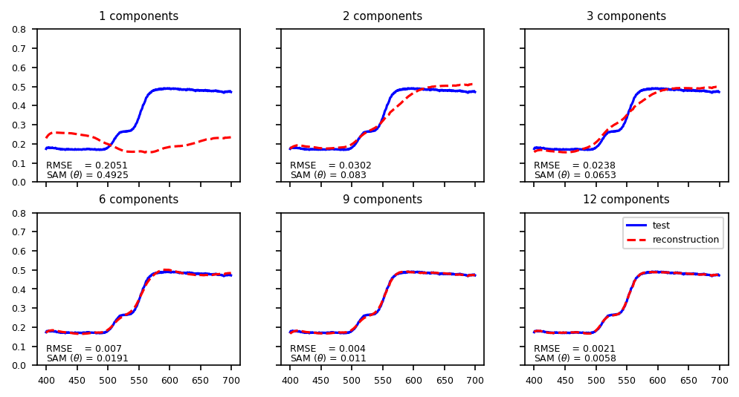
Reconstruction
Shown below is the sample reconstruction of a random Munsell reflectance spectrum using increasing number of principal components. At N = 3, the residual error of the reconstruction was reduced by almost ten-folds and the shape similarity has improved by seven-folds. At N = 6 onwards, the reconstruction is almost perfect with imperceivable errors.

Slide 9
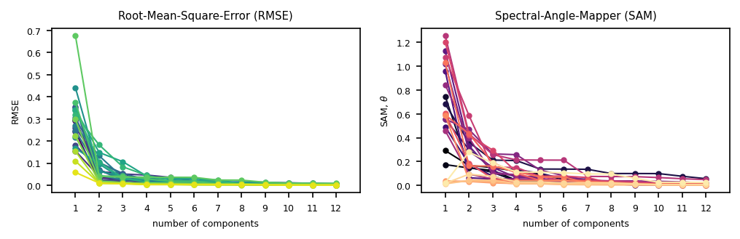
Reconstructing Macbeth
Shown below are the accuracies for the reconstruction of the 24 reflectance spectra from the Macbeth color chart. At N = 3, majority of the patches have RMSE < 0.1 and SAM < 0.2, quite low even though these were not part of the PCA ensemble where eigenvectors were obtained.
Aside from spectral accuracy, we employed color difference ΔE₇₆ which measures the Euclidean distance between the two spectra transformed in the CIELAB uniform color space [5]. In short, ΔE₇₆ quantifies how perceptually different the actual Macbeth color signals are from the PCA reconstructed spectra. From here onwards, we use (N = 3) three principal components.

Slide 10
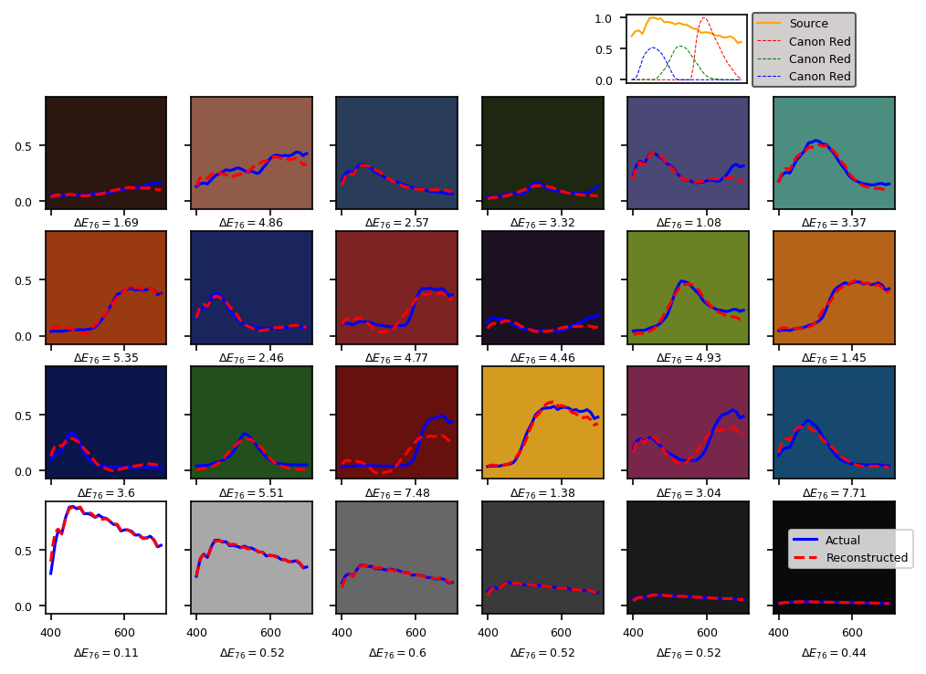
D65

Slide 11
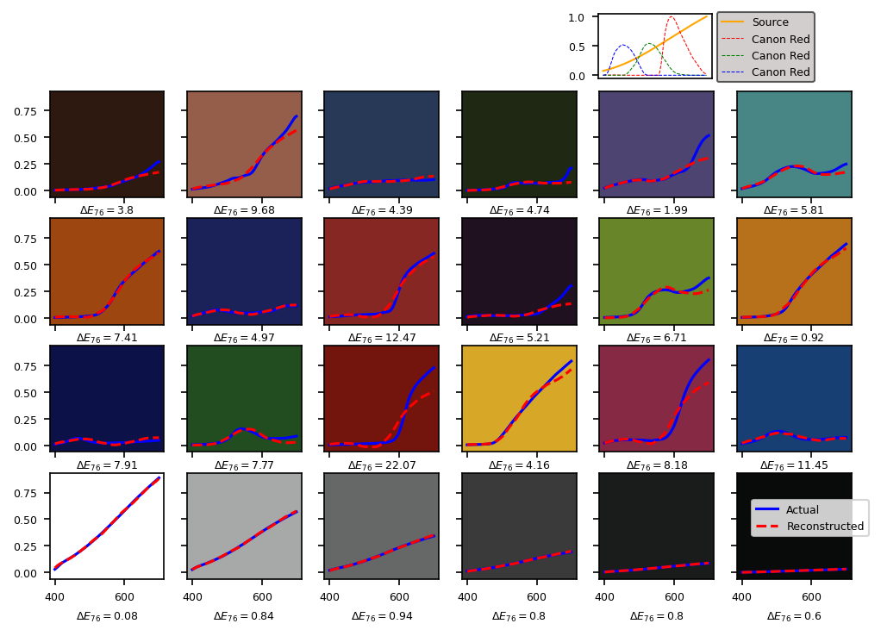
Illuminant A

Slide 12
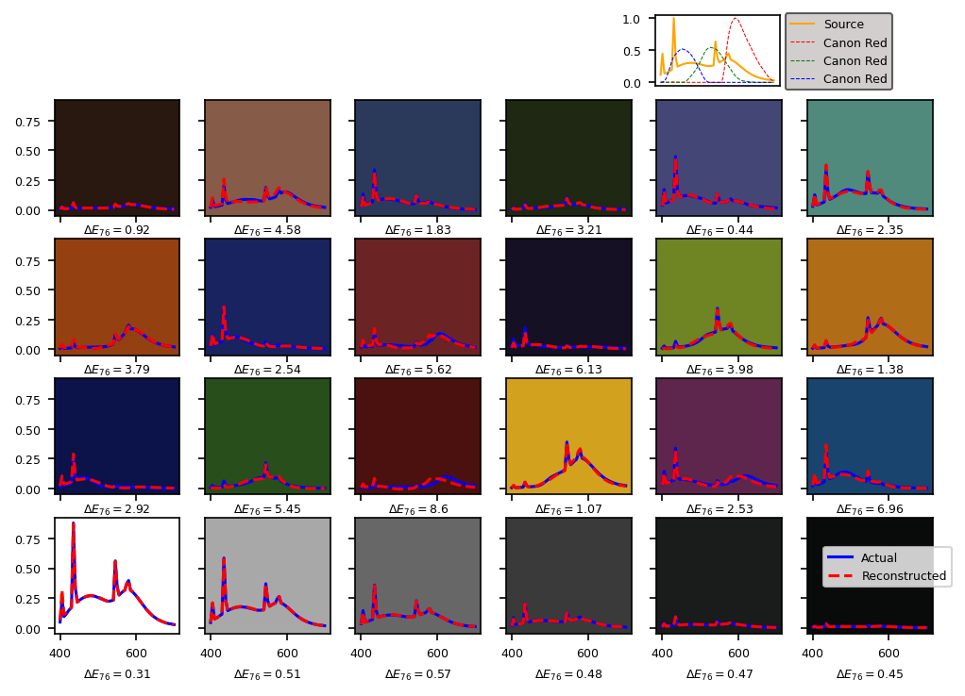
Flourescent

Slide 13
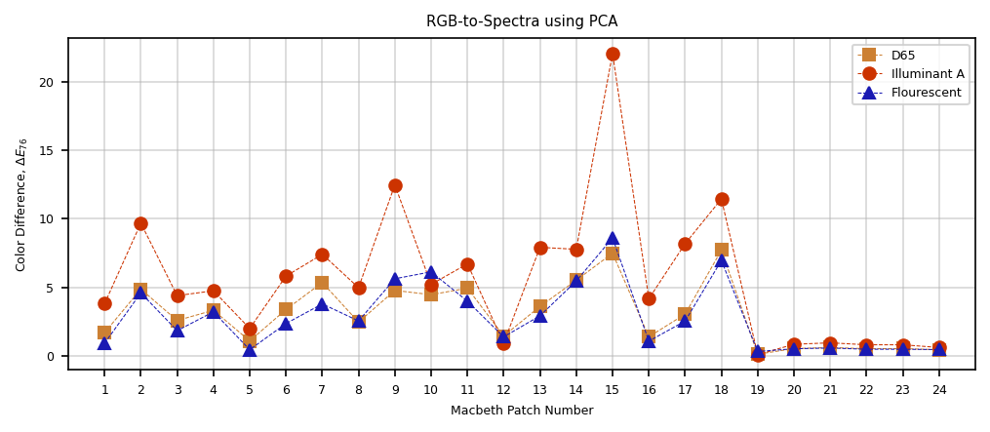
Discussion
Overall, we successfully reconstructed the never-before-seen Macbeth color spectra using the Transformation Matrix derived from the Munsell ensemble’s eigenvectors. Across different illuminants, majority of the reconstructions returned imperceivable color difference (ΔE₇₆ < 10) [5], with a few exceptions due to Illuminant A which has a skewed power spectrum.

Slide 14
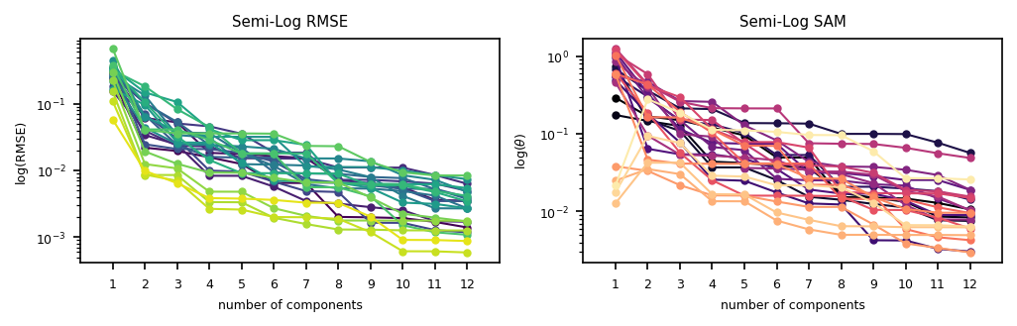
Conclusions
Both the spectral (RMSE, SAM) and colorimetric (ΔE₇₆) accuracy has shown how we can accurately depict large datasets with only a few representative values through Principal Components Analysis.
In this activity, we were able to convert a digital camera into a spectral imager where the RGB digital counts were found sufficient to reconstruct the high-dimensional spectral information using PCA.

Slide 15
reflection
As mentioned previously, I have used PCA before in spectral resolution but in this report, I was able to compare how the method fared across all different light sources. The visualizations were stand-alone and self-explanatory. One important finding is that it turns out, the skewed power distribution contributed to rendering spectra with large color difference. The take-away here is the same as what my undergraduate thesis proposed; we should implement both spectral and color error metrics to evaluate the spectral reconstruction.
In this activity, I’d give myself a score of 96/100.
[1] M. Soriano, Physics 301 – RGB-to-Spectra using PCA, (2022).
[2] sklearn.decomposition.PCA — scikit-learn 1.1.1 documentation
[3] J. P. S. Parkkinen, J. Hallikainen, and T. Jaaskelainen, Characteristic spectra of Munsell colors, J. Opt. Soc. Am. 6, 318 (1989).
[4] P. E. Dennison, K. Q. Halligan, and D. A. Roberts, A comparison of error metrics and constraints for multiple endmember spectral mixture analysis and spectral angle mapper, Remote Sens. Environ. 93, 359 (2004).
[5] W. Mokrzycki and M. Tatol, Color difference Delta E - A survey, Mach. Graph. Vis. 20, 383 (2011).

Slide 16
https://github.com/reneprincipejr/Physics-301/blob/main/01%20Color%20Segmentation/Activity%201%20-%20Color%20Segmentation.pdf
https://github.com/reneprincipejr/Physics-301/blob/main/02%20Spectral%20Imaging/Activity%202%20-%20Spectral%20Imaging.pdf
https://github.com/reneprincipejr/Physics-301/blob/main/03%20PCA%20for%20Compression/Activity%203%20-%20PCA%20for%20Compression.pdf
https://github.com/reneprincipejr/Physics-301/blob/main/04%20RGB-to-Spectra%20using%20PCA/Activity%204%20-%20RGB-Spectra%20using%20PCA.pdf

